Slide 1
The key
influencer
The key
influencer

Slide 2
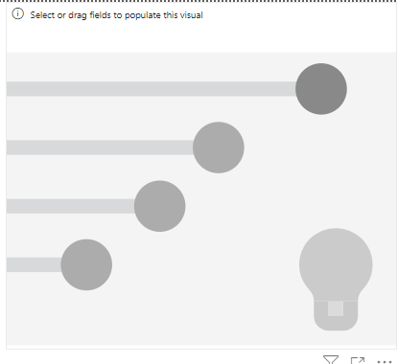
The key influencer
Note: This lab is based on the Excel file customerfeedback.xlsx in the Excel
Add a key influencer visual to the scene

Slide 3
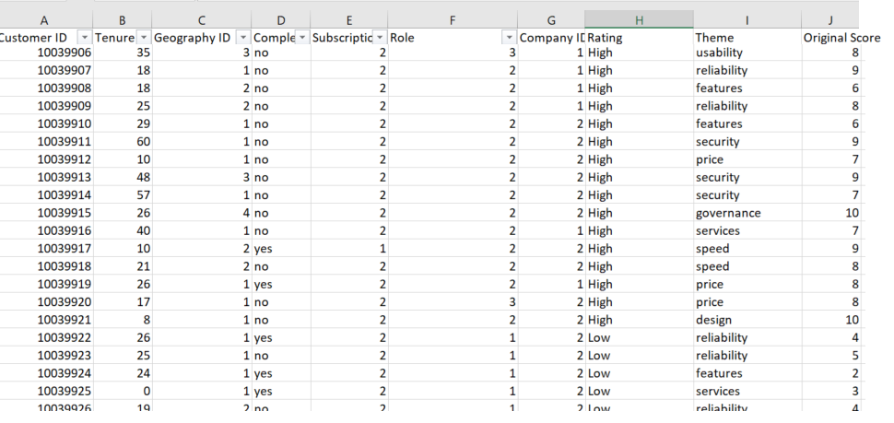
The key influencer
We need to study the impact of several factors on the customer original score either it is high or low

Slide 4
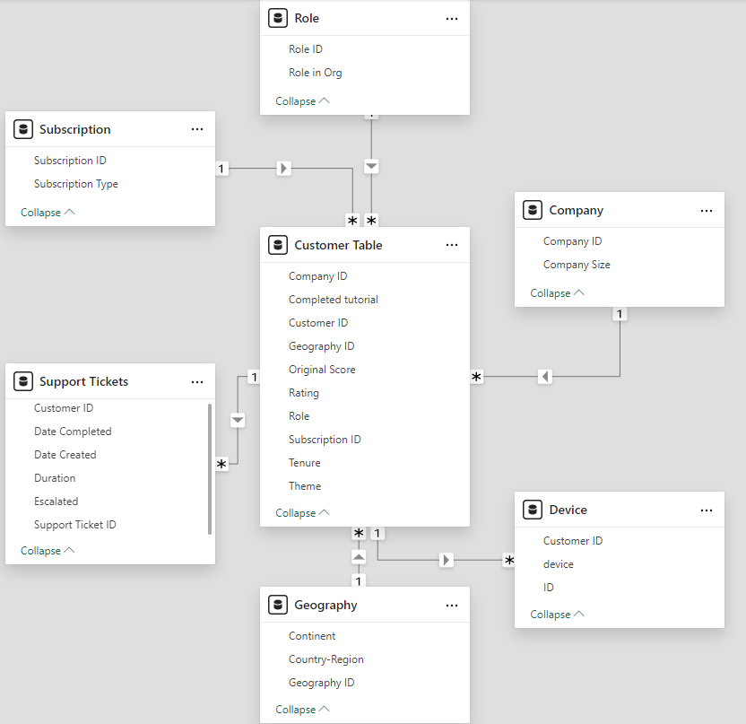
The key influencer
This is the model, the factors could be in central table which is the same sheet that holds original score or
sparate tables which are representing the other
sheets

Slide 5
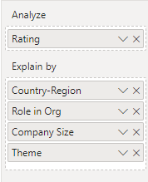
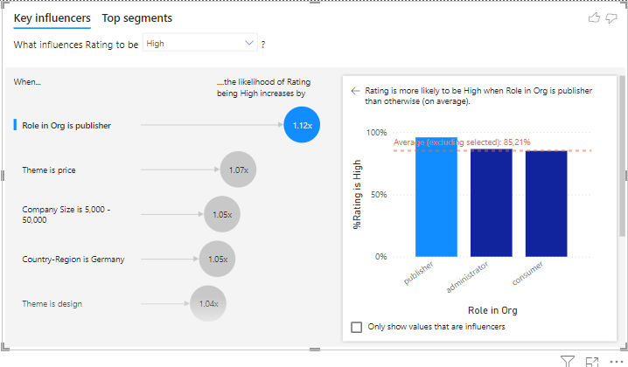
The key influencer
Add Assessment to analyze then Country-Region , Role in the organization ,
Company Size and Theme to be explained by and
observe the change

Slide 6
The key influencer
Role in the organization as “Publisher” :
The top influencers chart shows that being a publisher increases the likelihood of getting a high rating by 1.12x .
The bar chart validates this, showing 85.21% high ratings for publishers
Insight : Publishers have a significant positive impact on high ratings .
Recommendation : Focus on publisher engagement and retention, as they contribute the most to high ratings.

Slide 7
The key influencer
Themes :
Themes such as price and design have modest positive impacts ( 1.07x and 1.04x , respectively ).
Overview : These factors slightly increase satisfaction, indicating areas for further refinement.
Recommendation : Highlight competitive pricing and improve design elements to enhance satisfaction.

Slide 8
The key influencer
Regions and company size :
Germany and company size (5,000 to 50,000) contribute to a 1.05 times higher probability of receiving high scores .
Insight : These characteristics define the segments that are more likely to provide positive feedback .
Recommendation : Adapt your strategies to maintain satisfaction in Germany and in medium-sized companies.

Slide 9
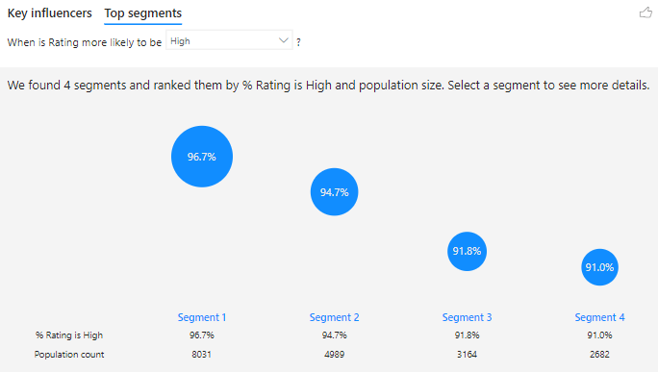
The key influencer
Analyze the best segments for a high score
Segments are ranked based on the percentage of high scores and population size .
Segment 1 (96.7% high scores, population: 8,031) represents the most satisfied group, followed by other segments with slightly lower scores (94.7%-91.0 %).
Overview : Segment 1 is the most important driver of high ratings due to its size and high satisfaction rate .
Recommendation : Identify the characteristics of this segment and reproduce its conditions in other groups.

Slide 10
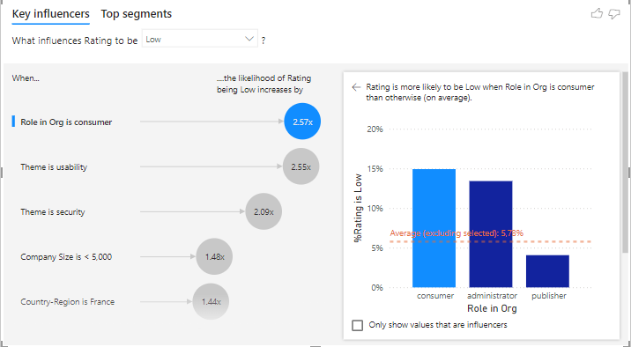
The key influencer
Role in the organization as a “consumer” :
The graph shows that consumers are 2.57 times more likely to give poor ratings. The bar graph shows that consumers exceed the average percentage of poor ratings ( 5.78% ).
Insight : Consumers are the most dissatisfied group.
Recommendation : Study their challenges and prioritize solving their problems.

Slide 11
The key influencer
Themes and company sizes :
usability and security significantly influence low scores ( 2.55x and 2.09x , respectively).
Small businesses (<5,000 employees) are 1.48 times more likely to give poor ratings.
Insight : Usability and security are major dissatisfaction factors, especially for small businesses.
Recommendation : Improve usability and security aspects, targeting small businesses.

Slide 12
The key influencer
Regions :
France is 1.44 times more likely to get poor grades.
Overview : Regional dissatisfaction may be linked to localized factors .
Recommendation : Investigate and address specific regional concerns, particularly in France.

Slide 13
The key influencer
Analyze the best segments for a high score
Segments are ranked based on the percentage of high scores and population size .
Segment 1 (96.7% high scores, population: 8,031) represents the most satisfied group, followed by other segments with slightly lower scores (94.7%-91.0 %).
Overview : Segment 1 is the most important driver of high ratings due to its size and high satisfaction rate .
Recommendation : Identify the characteristics of this segment and reproduce its conditions in other groups.

Slide 14
Thank you
Thank you

